Slide 1
Array Copy acceleration using AVX-512 masked instructions

Slide 2
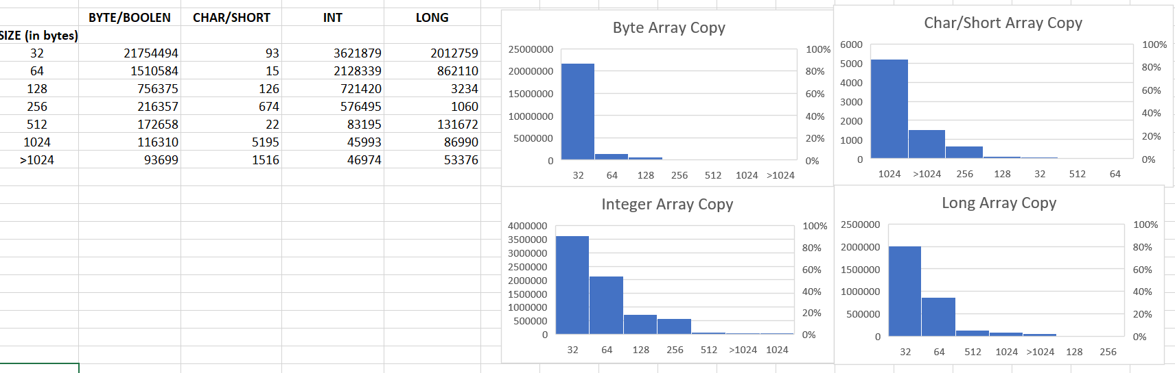
Background:
JVM arraycopy operation is called for following Java library APIs:-
System.arraycopy()
Arrays.copyOf()
Object cloning – array and instance objects.
2. Currently in order to perform copy operation compiler emits a call to copy stub.
A stub is a hand-crafted assembly sequence which is assembled during VM startup initialization.
3. Following histogram show call frequency profile of various array copy operation in SPECjbb2015:-

Slide 3
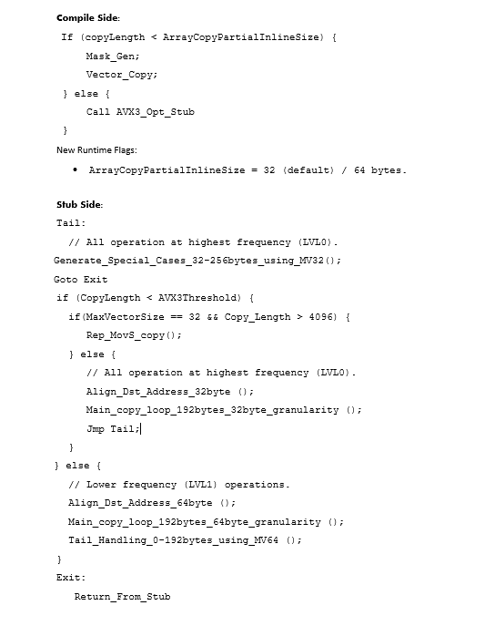
Two step optimization:-
Partial In lining :
For small sized copy blocks ( > 32 bytes) compiler emits optimized instruction sequence using masked instructions at the call site.
This save lots of call over head (argument preparation , caller save spills, additional branches and conditions in stubs etc.)
Inline size is configurable to 64 bytes, in this case 64 byte ZMM registers are used.
Optimized stubs:
Specialized instruction sequence for various copy blocks size ranging from 32 – 192 bytes.
Destination aligned fat copy loop, copy 192 byte data in one iteration, this save expensive cache splits during vector load and stores.
All the special block operate using 32 byte vector registers if copy size is less than AVX3Threshold (4096 bytes).
Fast REP MOVS is used if user forces the use of 32 byte vectors for bigger copy sizes ( > 4096 bytes).

Slide 4
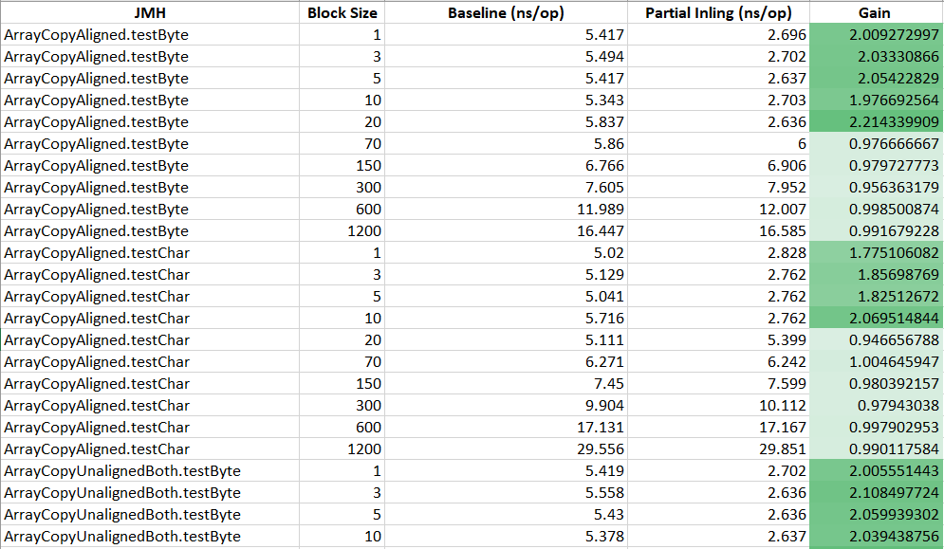
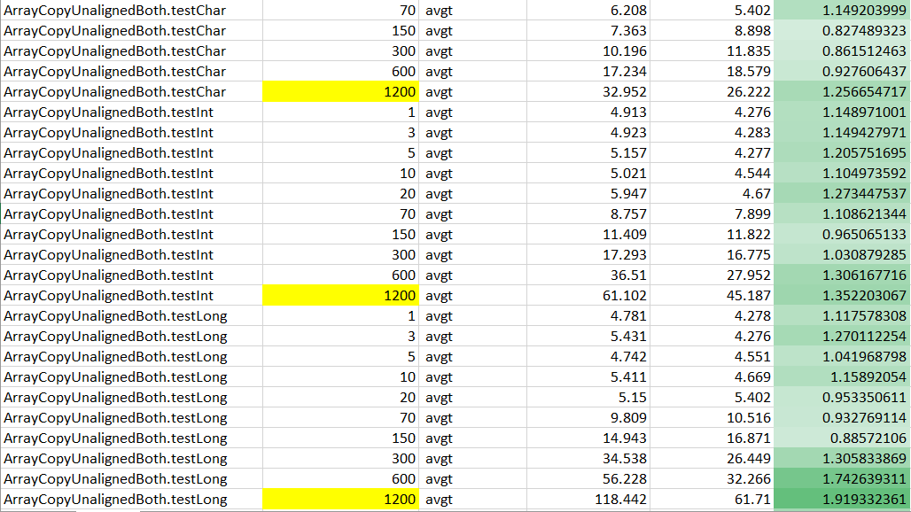
Perf Results: Java micro benchmarks (CLX 28C – 2S)
Partial in-lining
New stubs
\\jpe-gateway-01\PersonalDirectories\jatinbha\PERF_RESULTS\JMH_PI_CLX_28C_2S.xlsx
\\jpe-gateway-01\PersonalDirectories\jatinbha\PERF_RESULTS\JMH_Stubs_CXL_28C_2S.xlsx

Slide 5
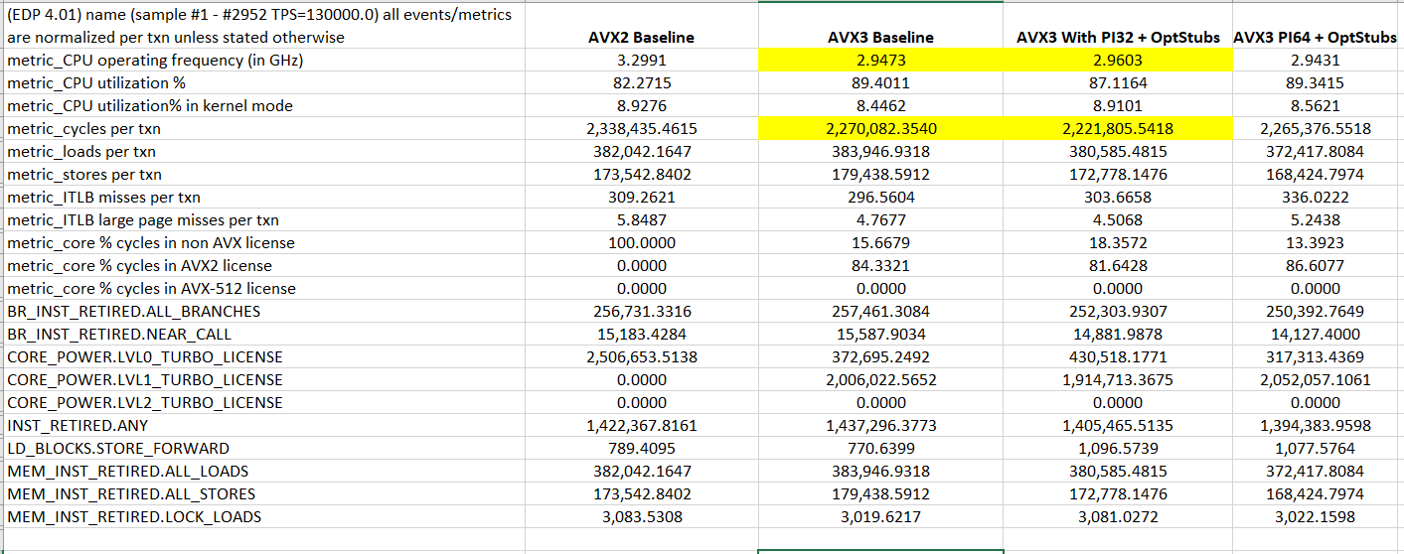
Perf Results : SPECjbb2015 (CLX 28C-2S)
Cumulative cycles spent in various array copy operation in benchmarks is less than 1.5%, thus no-perceptible changes in max-jops or critical jops.
Detailed EMON data show improvement on various fronts (cycles, instruction count, branches, near calls).
\\jpe-gateway-01\PersonalDirectories\jatinbha\PERF_RESULTS\specjbb_arraycopy_opts_CLX_28C-2S.xlsx

Slide 6
Other Perf results:
JMH Partial in-lining - AMD 24C – 2S vs ICX – 24C- 2S [both at fixed frequency 2.2Ghz]
\\jpe-gateway-01\PersonalDirectories\jatinbha\PERF_RESULTS\JMH_AMD_24C-2S.txt
\\jpe-gateway-01\PersonalDirectories\jatinbha\PERF_RESULTS\JMH_ICX_PI32.txt
SPECjbb2015 ICX – 24C 2S [Floating frequency]
\\jpe-gateway-01\PersonalDirectories\jatinbha\PERF_RESULTS\specjbb_arraycopy_opts_ICX_24C-2S_floating_frequency.xlsx

